Slide 1
Auto-tagging online content
for
content market efficiency
Arkaprabha Majumdar(2018MSBDA015)

Slide 2
Content
Need for Auto-tagging of online content
Data Collection
Data Preprocessing
Data Preparation
Topic extraction using Latent Dirichlet Allocation(LDA)
Algorithm Selection and Implementation
Results
Reference

Slide 3
Objective of the presentation:Why auto-tagging online content?
For content marketers and decision makers
Unstructured large Data scattered across platforms
Manually tagging online content is problematic
For proper content marketing management

Slide 4
workflow
DATA PARSING
DATA PREPROCESSING
KEYWORDS GENERATION
LDA (To assign labels)
CLASSIFICATION

Slide 5
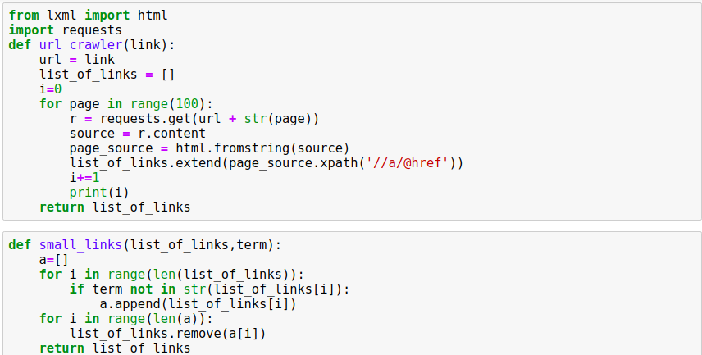
Data Collection - URL parsing

Slide 6
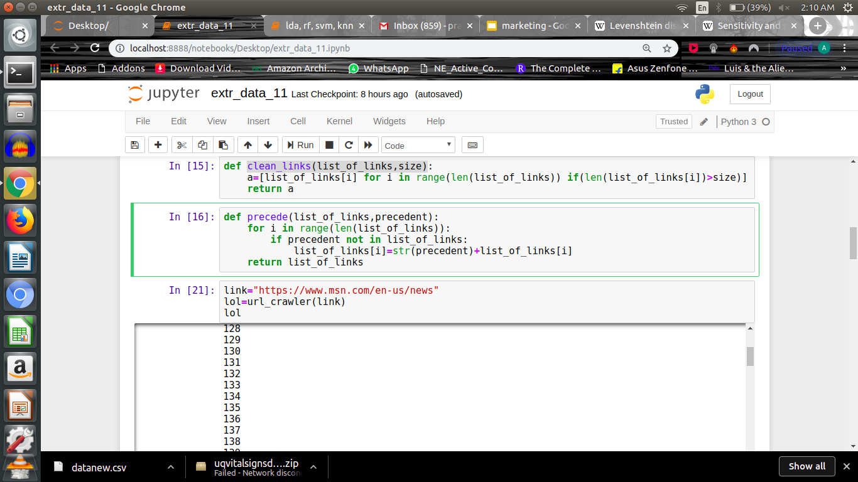
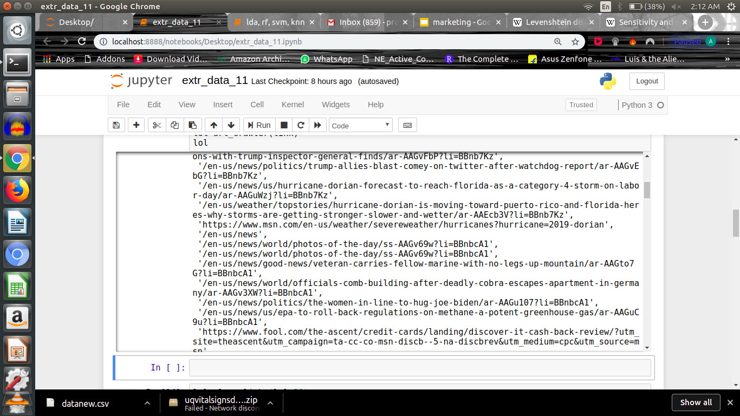

Slide 7
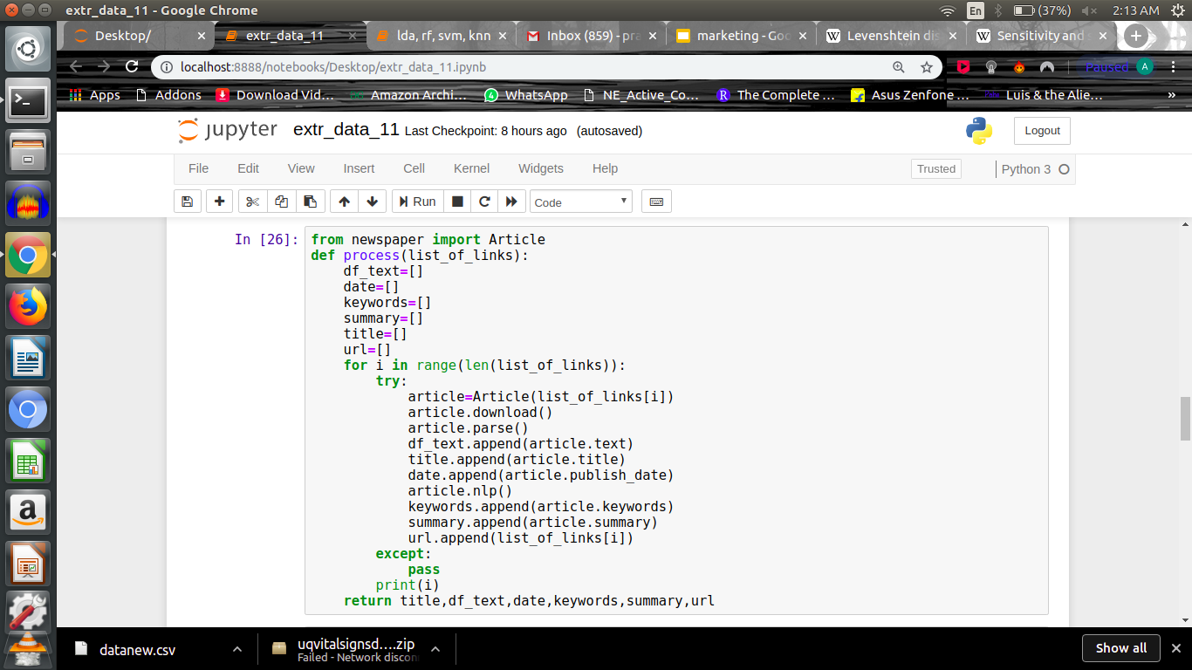
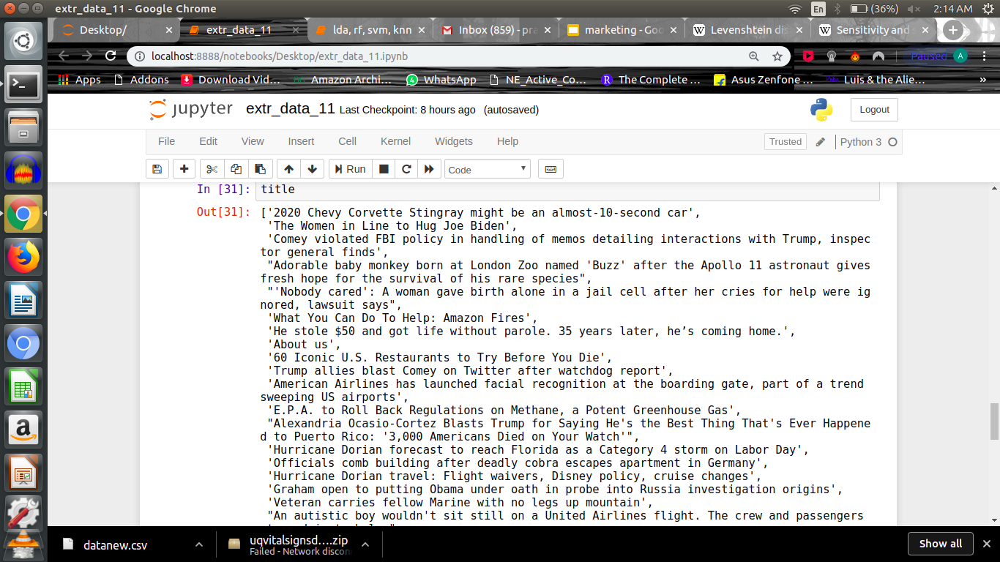
Keyword Extraction from Articles using NLP
title,text,date,keywords,summary,url=process(list(set(lol)))
data=pd.DataFrame({"description":title,"text":text,"date":date,"keywords":keywords,"summary":summary,"url":url})

Slide 8
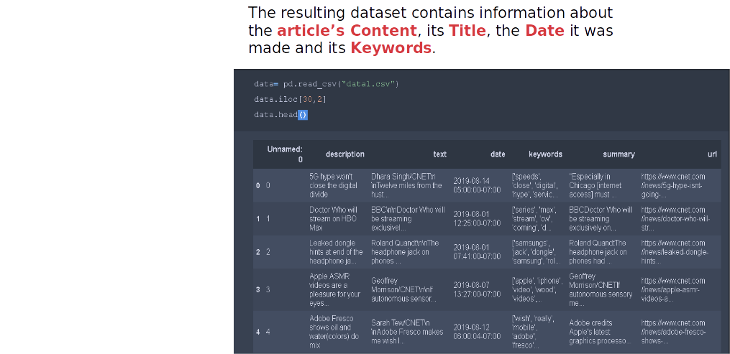
Data Preparation

Slide 9
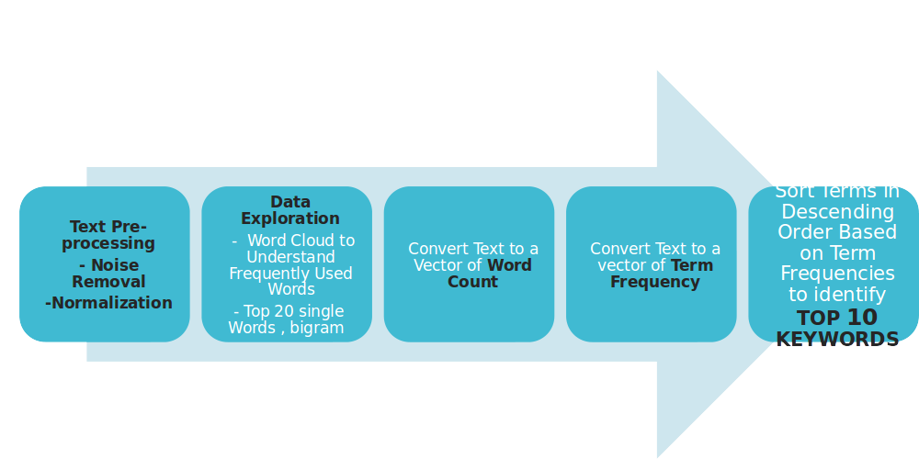

Slide 10
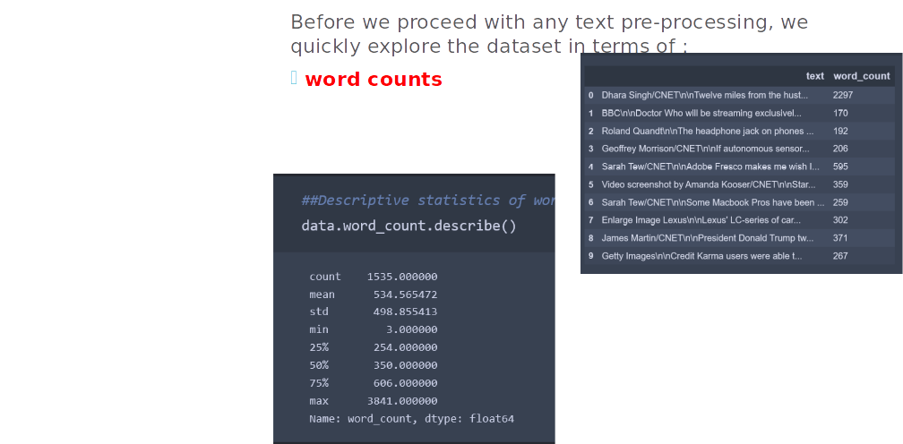

Slide 11
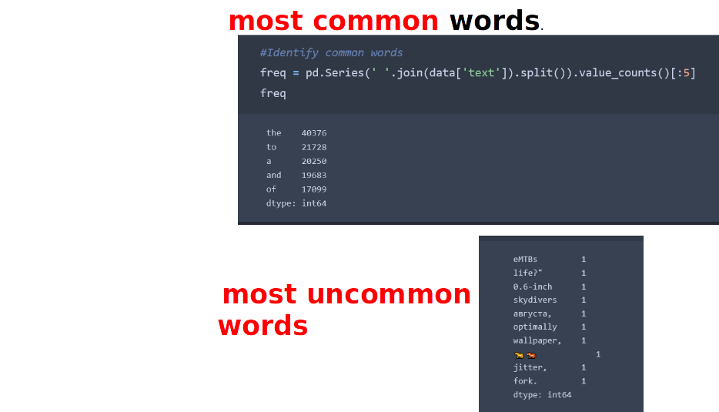

Slide 12
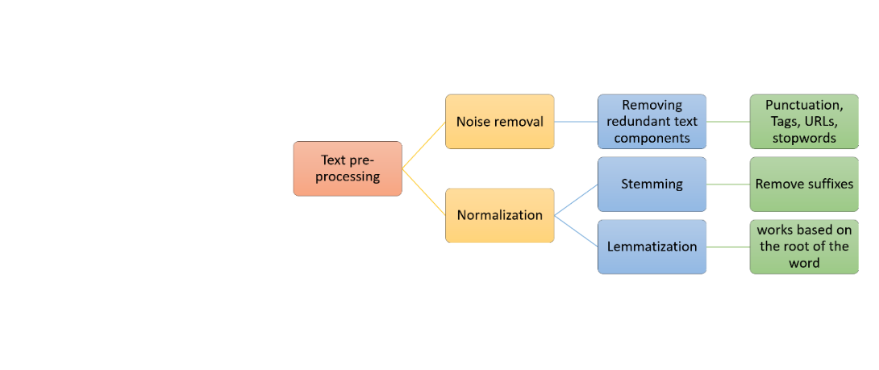

Slide 13
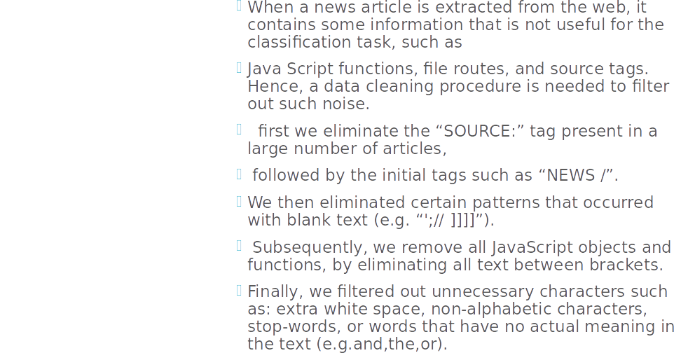

Slide 14
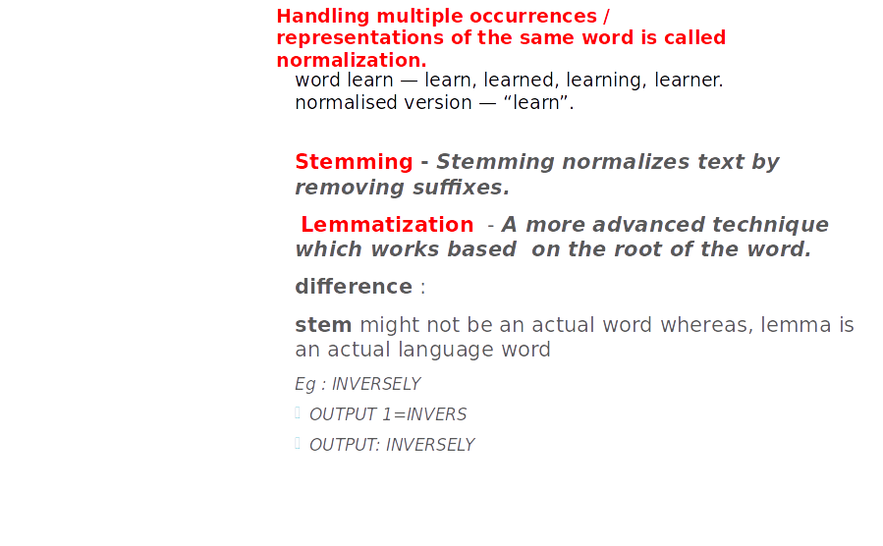

Slide 15
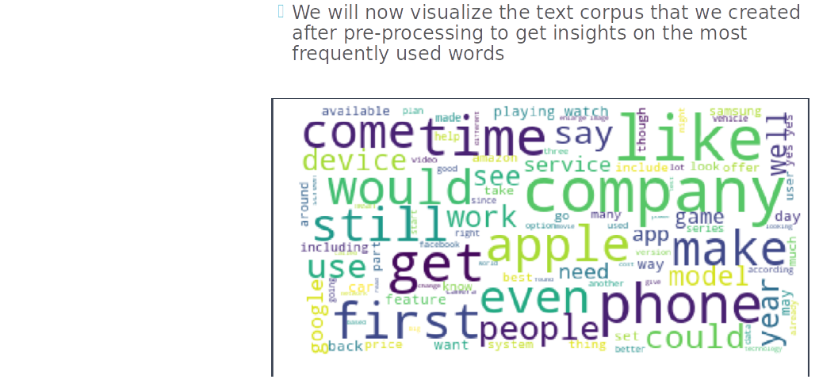

Slide 16
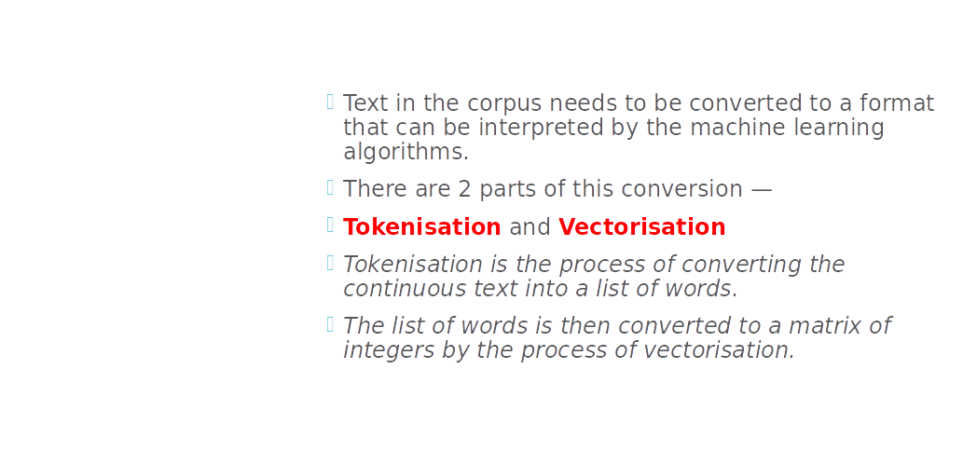

Slide 17
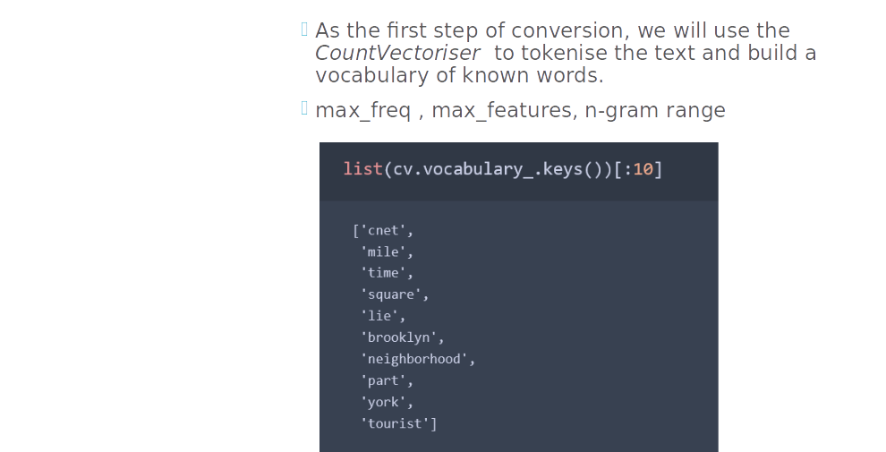

Slide 18
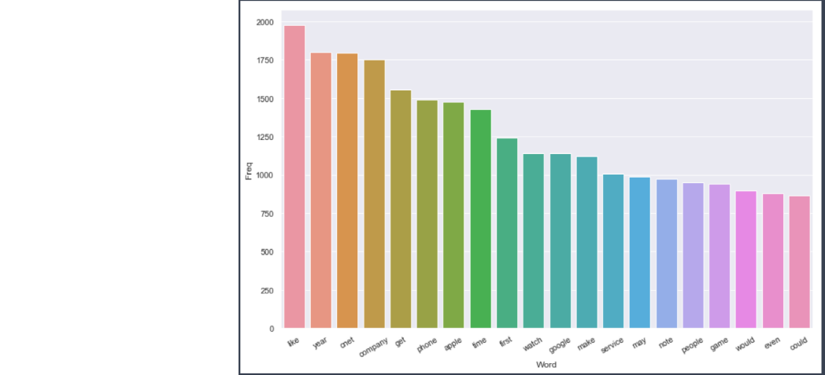

Slide 19
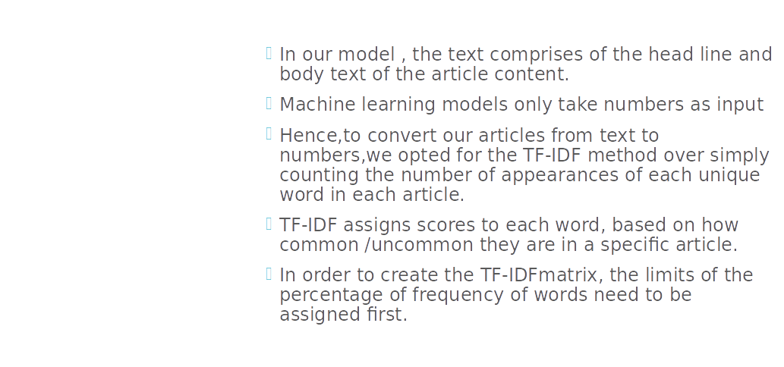

Slide 20
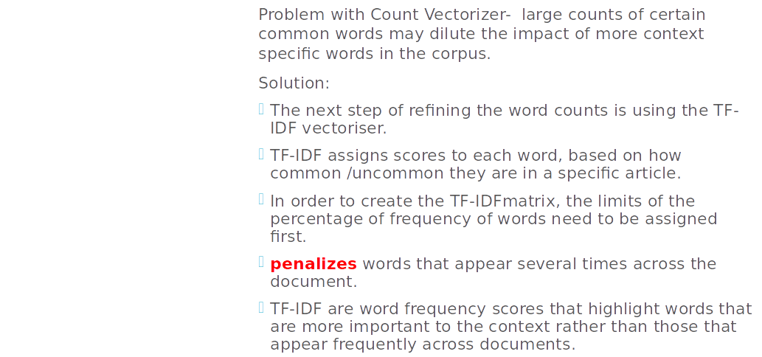

Slide 21
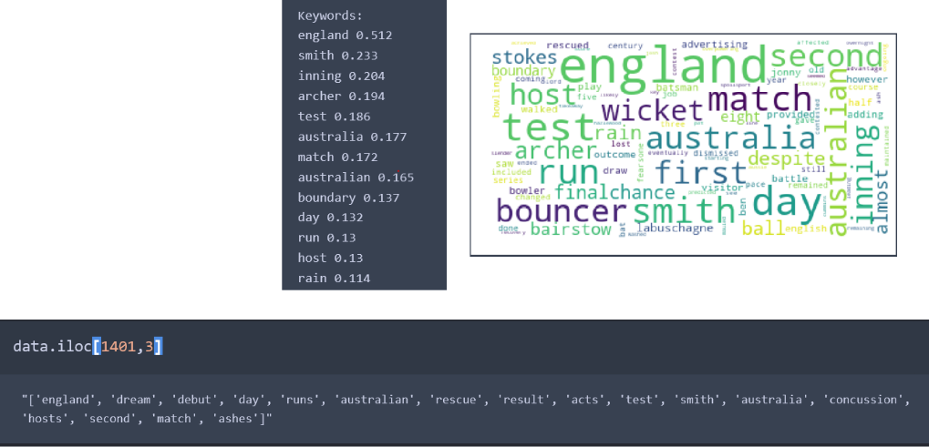

Slide 22
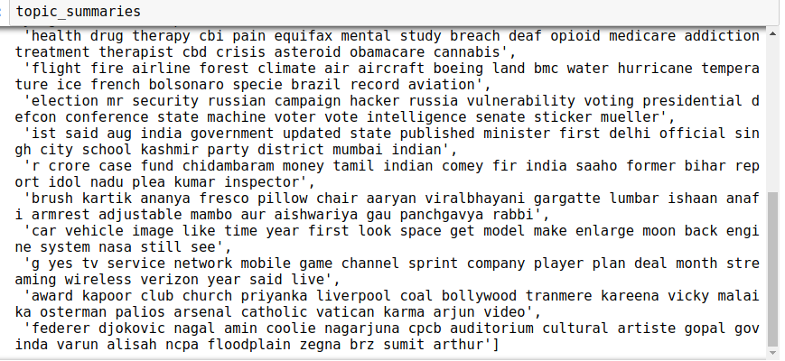
Topic extraction using LDA
To assign labels to the data now we’ll use tf-idf matrix for topic modeling
Using the LDA Algorithm for topic modelling
We found 20 topics which will be used to obtain labels

Slide 23
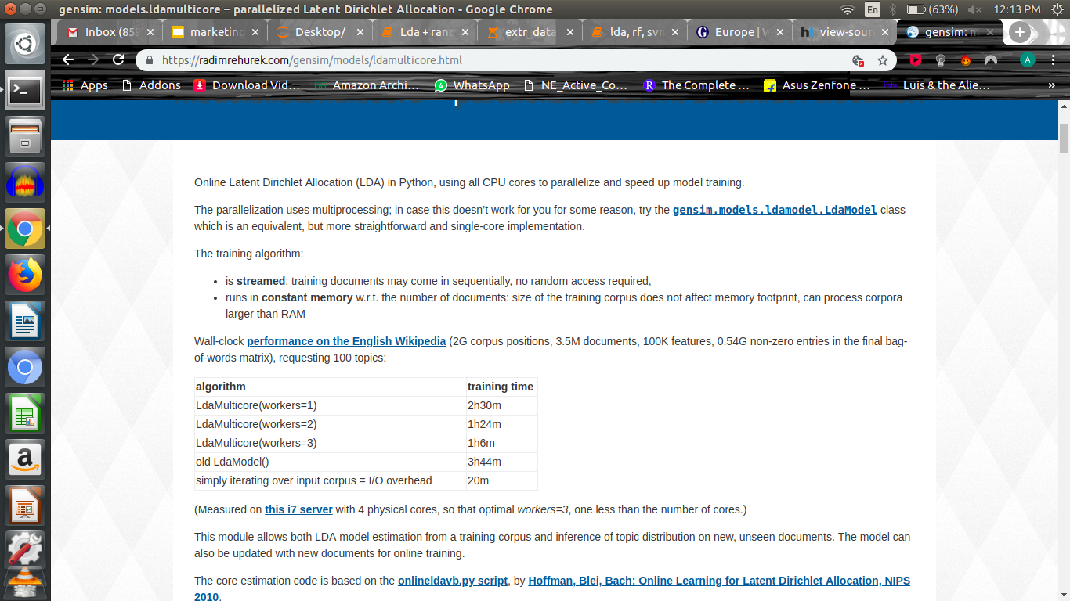
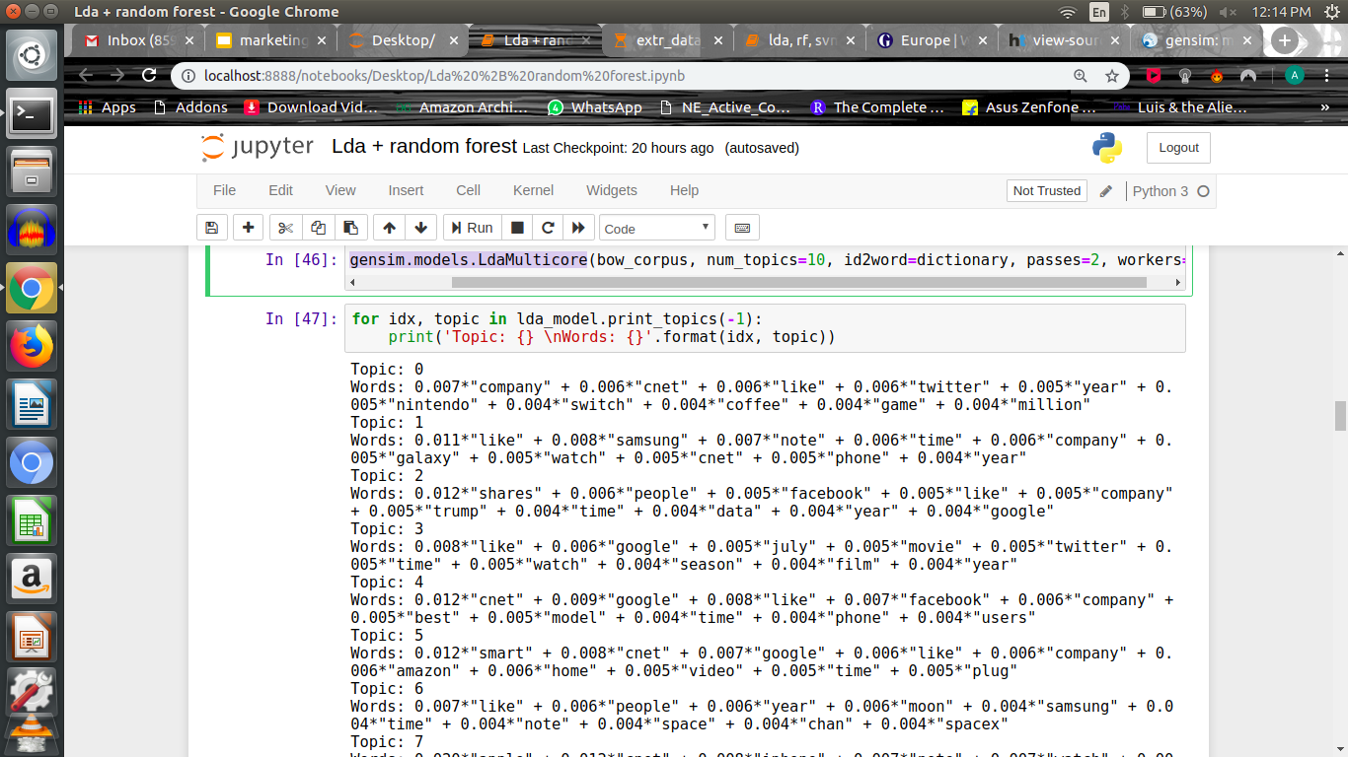
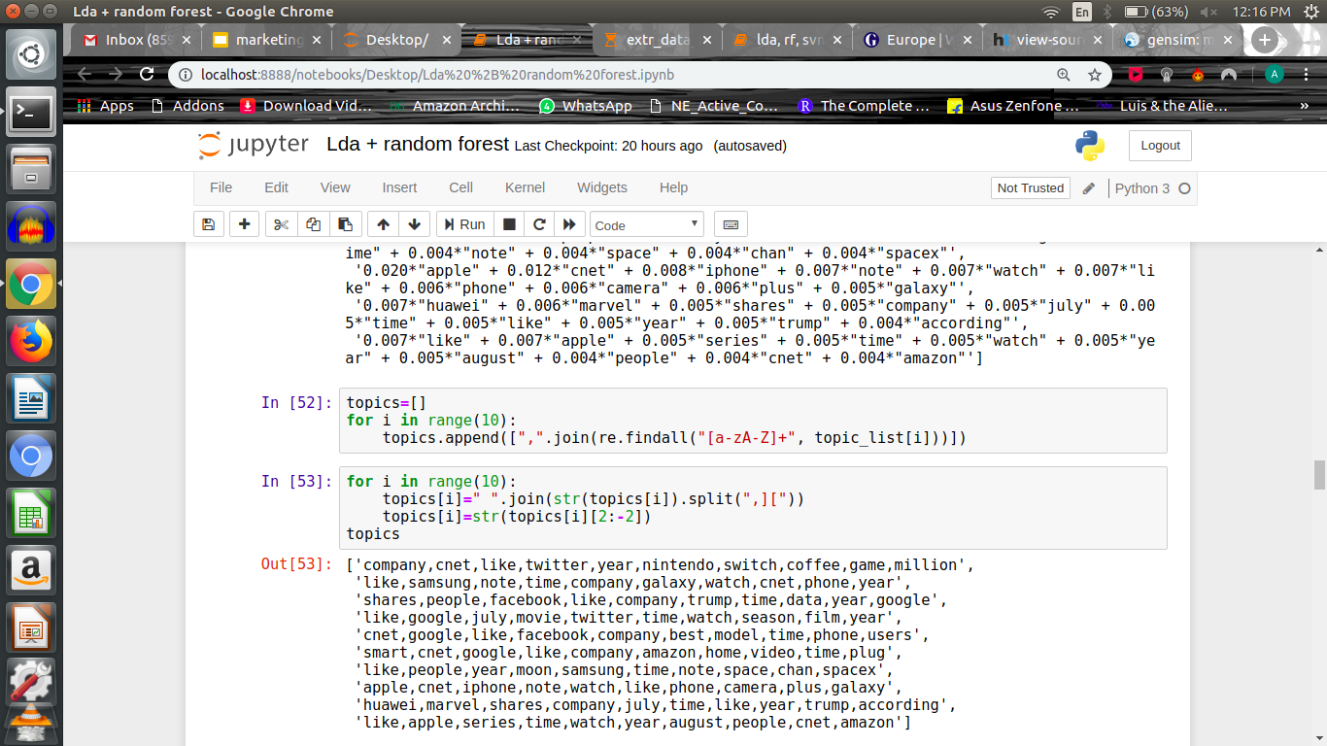
Using Gensim :-

Slide 24
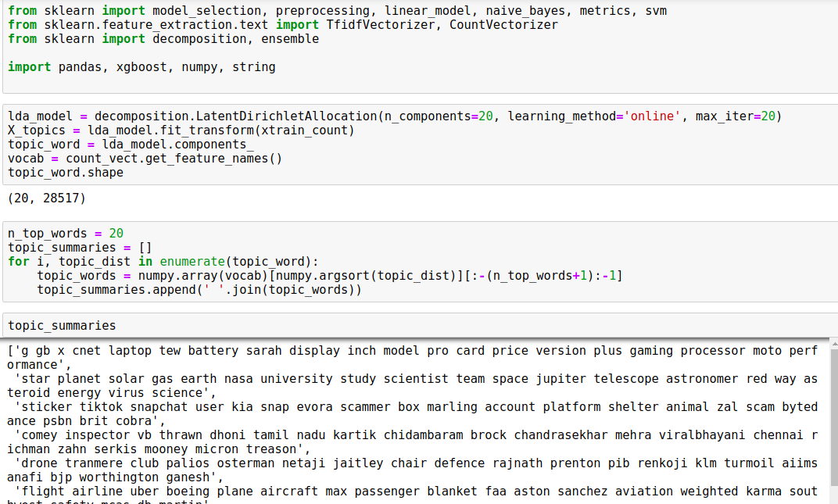
Using SkLearn :-

Slide 25
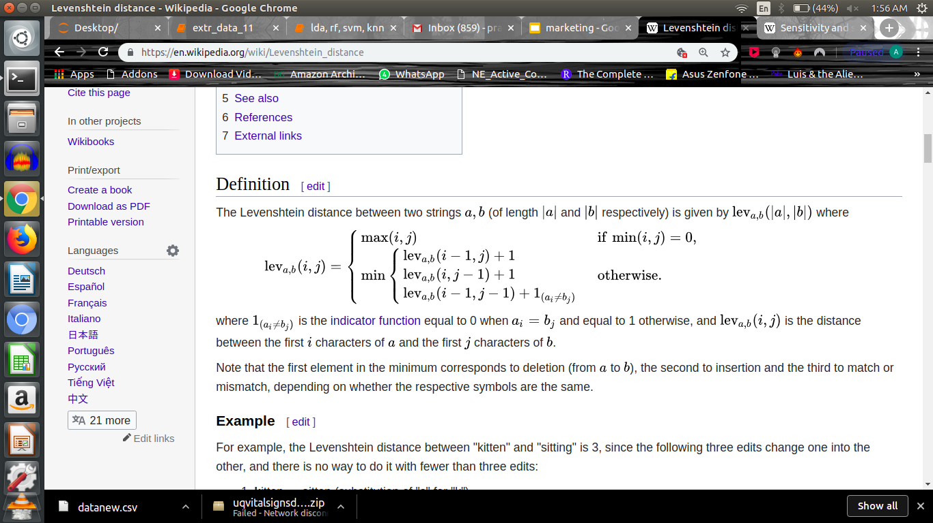
Levenstein ? A new metric
Deletion
Insertion
Match / Mismatch
Eg:
kitten > sitten (substitution of "s" for "k")
sitten > sittin (substitution of "i" for "e")
sittin > sitting (insertion of "g" at the end).

Slide 26
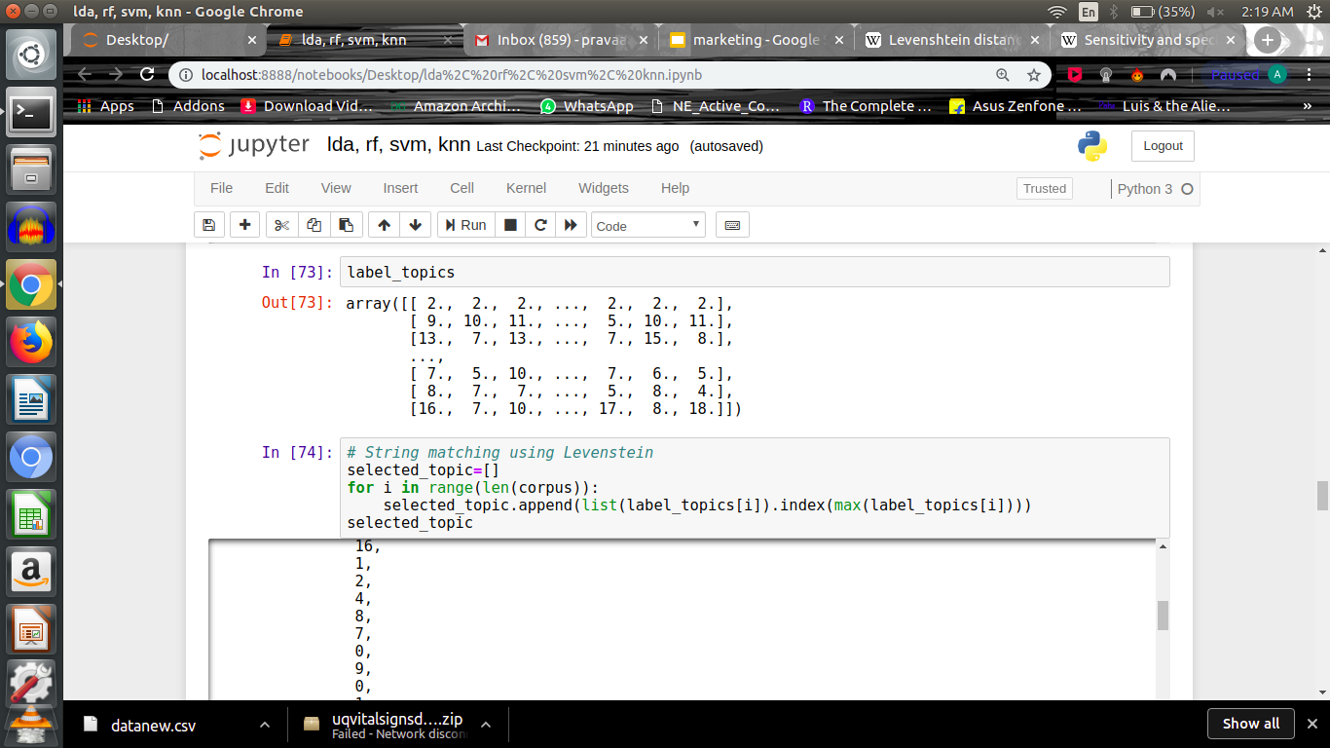
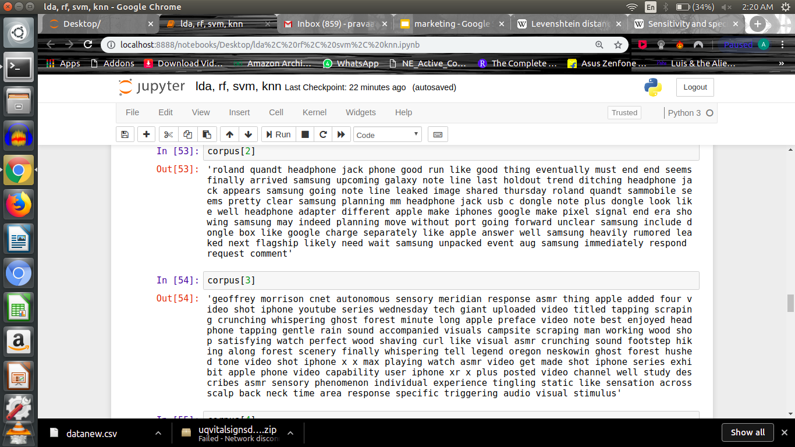

Slide 27
Algorithm selection :-
Best three of them proved to be-
Multinomial NB
K Nearest Neighbor
Random Forest
Neural Network (MLP)
KNN and Random Forest require dimensionality reduction technique applied to high dimensional data before training

Slide 28
Evaluation metrics
F1 Score :- Harmonic mean of two metrics Precision and Recall.
F1= 2*( Precision*Recall) / ( Precision+Recall)
Where Precision measures how well the model avoids assigning wrong keywords to an article
And Recall measures how well the model assigns keywords correctly to an article
Confusion Matrix

Slide 29
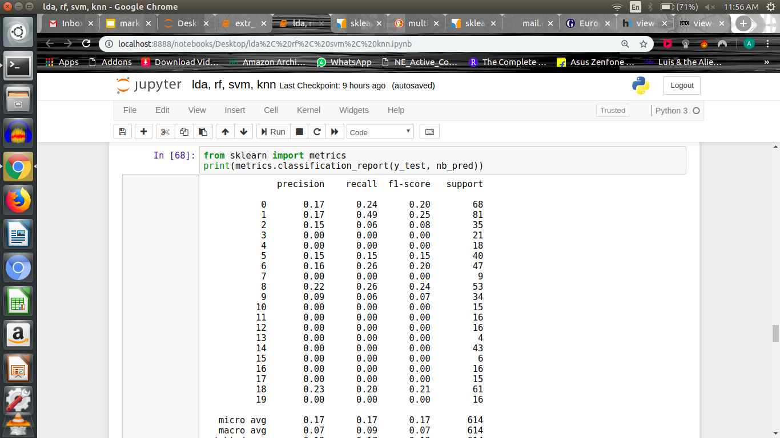
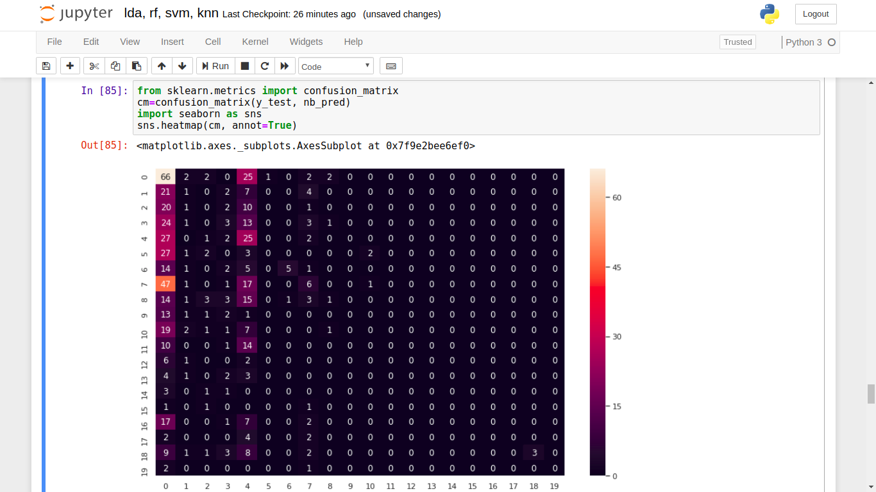
Results
Multinomial NB :-

Slide 30
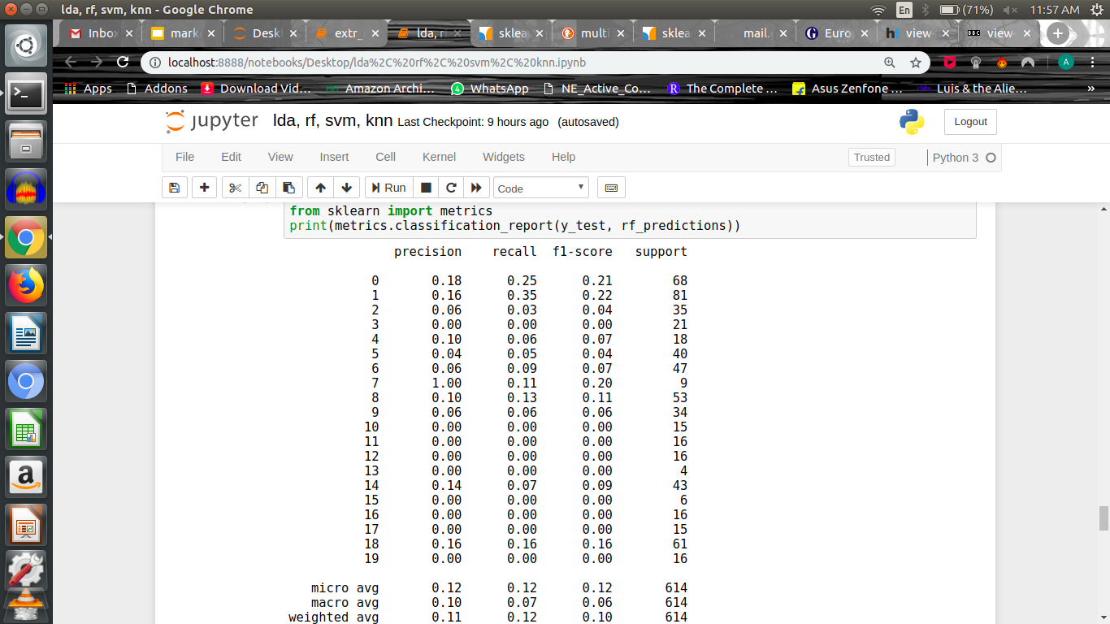
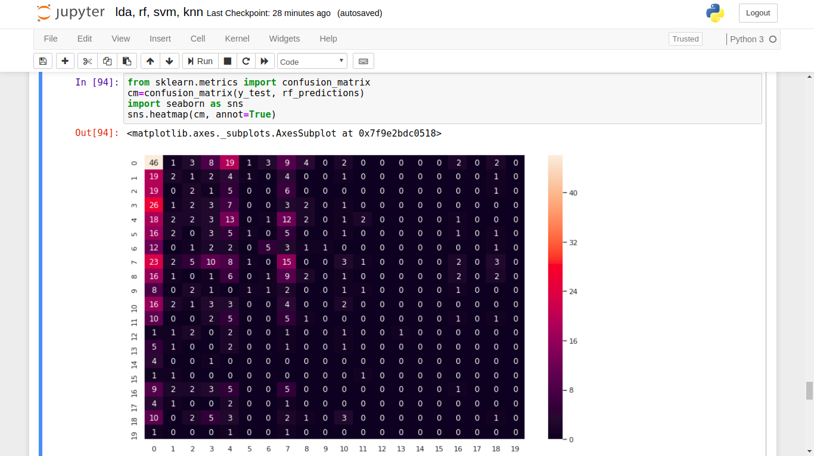
Results(contd.)
Random Forest :-

Slide 31
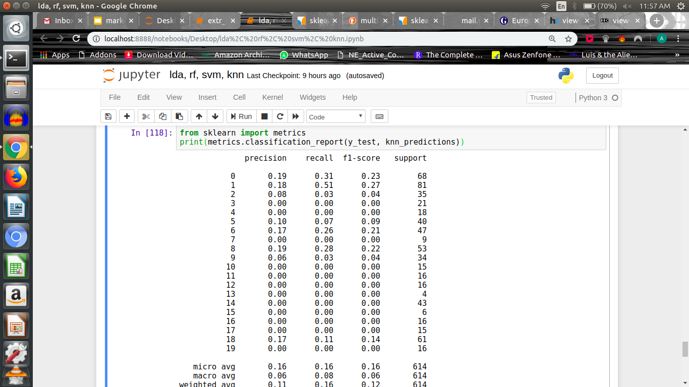
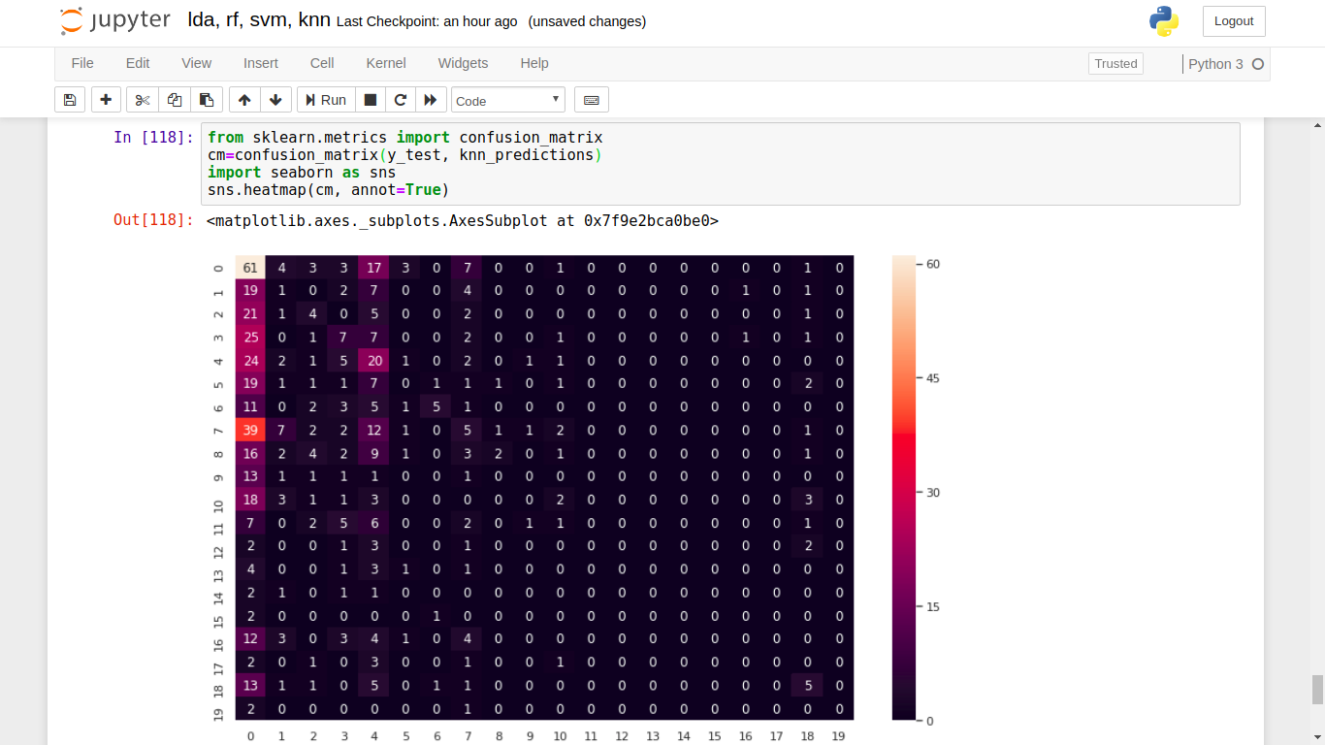
K Nearest Neighbours :-
(k=15)

Slide 32
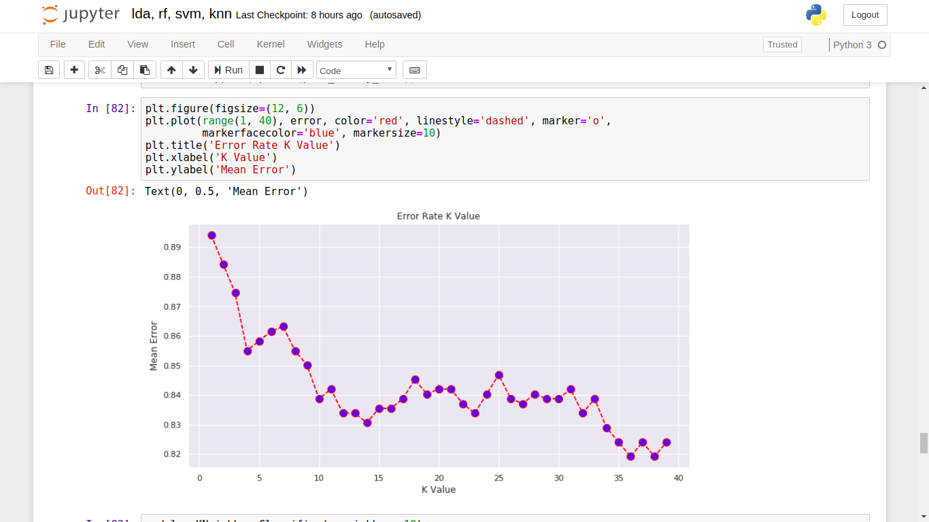
Elbow plot for the selection of k :-

Slide 33
Run time Dilemma
Computing the algorithms ‘run time’ (i.e.,time taken to fit the model):
KNN :is the fastest, taking only 0.184 s to run on a test set of 10,000 articles
Random Forest takes 5.612 and
NN takes 14.668s on the same data.

